Slide 1
About Me
Ritesh Singh
Sun Certified java Programmer
Oracle Certified Database Administrator
Certified Ethical Hacker
Certified EC-Council Instructor (CEI)

Slide 2
Course Overview
What is Class?
What is Class Diagram?
UML Class Notation
Perspectives of Class Diagram
Relationships between classes
Example of Class Diagram

Slide 3
What is Class
A Class is a blueprint that is used to create Object.
The Class defines what object can do.
Example:
A dog has states - color, name, breed as well as behaviors -wagging, barking, eating. An object is an instance of a class.

Slide 4
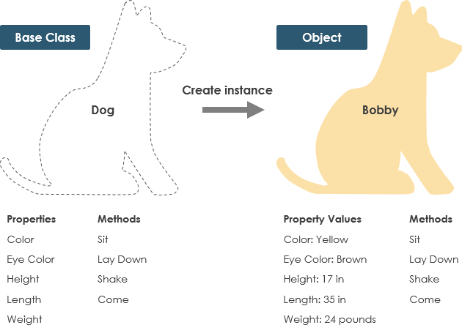
Example of Class:

Slide 5
What is Class Diagram?
Class Diagram defines the types of objects in the system and the different types of relationships that exist among them. It gives a high-level view of an application. This modeling method can run with almost all Object-Oriented Methods. A class can refer to another class. A class can have its objects or may inherit from other classes.
Class Diagram helps construct the code for the software application development

Slide 6
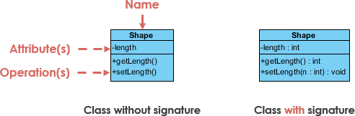
UML Class Notation
A class represent a concept which encapsulates state (attributes) and behavior (operations). Each attribute has a type. Each operation has a signature. The class name is the only mandatory information.
Class Name:
The name of the class appears in the first partition.

Slide 7
Class Attributes:
Attributes are shown in the second partition.
The attribute type is shown after the colon.
Attributes map onto member variables (data members) in code.

Slide 8
Class Operations (Methods):
Operations are shown in the third partition. They are services the class provides.
The return type of a method is shown after the colon at the end of the method signature.
The return type of method parameters are shown after the colon following the parameter name. Operations map onto class methods in code

Slide 9
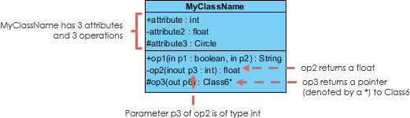

Slide 10
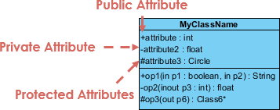
Class Visibility
The +, - and # symbols before an attribute and operation name in a class denote the visibility of the attribute and operation.
+ denotes public attributes or operations
- denotes private attributes or operations
# denotes protected attributes or operations

Slide 11
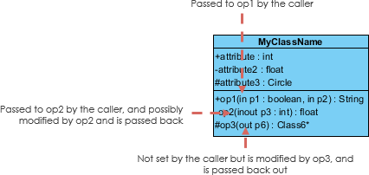
Parameter Directionality
Each parameter in an operation (method) may be denoted as in, out or inout which specifies its direction with respect to the caller. This directionality is shown before the parameter name.

Slide 12
Perspectives of Class Diagram
The choice of perspective depends on how far along you are in the development process. During the formulation of a domain model, for example, you would seldom move past the conceptual perspective. Analysis models will typically feature a mix of conceptual and specification perspectives. Design model development will typically start with heavy emphasis on the specification perspective, and evolve into the implementation perspective.

Slide 13
A diagram can be interpreted from various perspectives:
Conceptual: represents the concepts in the domain
Specification: focus is on the interfaces of Abstract Data Type (ADTs) in the software
Implementation: describes how classes will implement their interfaces
The perspective affects the amount of detail to be supplied and the kinds of relationships worth presenting. As we mentioned above, the class name is the only mandatory information.

Slide 14
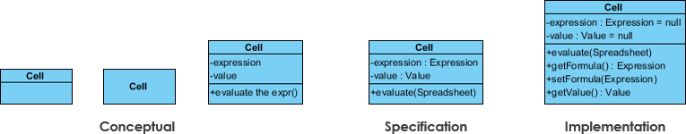

Slide 15
Relationships between classes
UML is not just about pretty pictures. If used correctly, UML precisely conveys how code should be implemented from diagrams. If precisely interpreted, the implemented code will correctly reflect the intent of the designer. Can you describe what each of the relationships mean relative to your target programming language shown in the Figure below?
If you can't yet recognize them, no problem this section is meant to help you to understand UML class relationships. A class may be involved in one or more relationships with other classes.

Slide 16
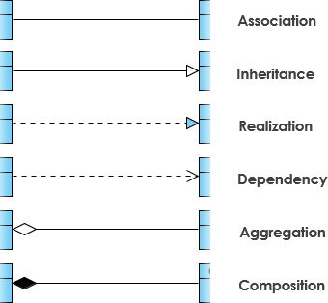
A relationship can be one of the following types:

Slide 17
Inheritance (or Generalization):
A generalization is a taxonomic relationship between a more general classifier and a more specific classifier. Each instance of the specific classifier is also an indirect instance of the general classifier. Thus, the specific classifier inherits the features of the more general classifier.
Represents an "is-a" relationship.
An abstract class name is shown in italics.
SubClass1 and SubClass2 are specializations of SuperClass.

Slide 18
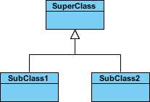
The figure below shows an example of inheritance hierarchy. SubClass1 and SubClass2 are derived from SuperClass. The relationship is displayed as a solid line with a hollow arrowhead that points from the child element to the parent element.

Slide 19
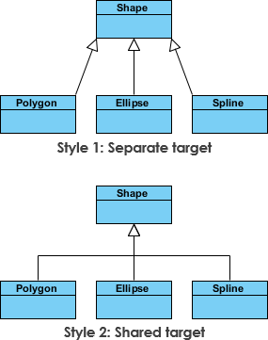
Inheritance Example - Shapes
The figure below shows an inheritance example with two styles. Although the connectors are drawn differently, they are semantically equivalent.

Slide 20
Association
Associations are relationships between classes in a UML Class Diagram. They are represented by a solid line between classes. Associations are typically named using a verb or verb phrase which reflects the real world problem domain.

Slide 21

Simple Association
A structural link between two peer classes.
There is an association between Class1 and Class2
The figure below shows an example of simple association. There is an association that connects the <<control>> class Class1 and <<boundary>> class Class2. The relationship is displayed as a solid line connecting the two classes.

Slide 22
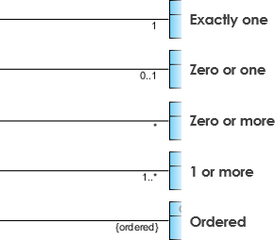
Cardinality
Cardinality is expressed in terms of:
one to one
one to many
many to many

Slide 23
Aggregation
A special type of association.
It represents a "part of" relationship.
Class2 is part of Class1.
Many instances (denoted by the *) of Class2 can be associated with Class1.
Objects of Class1 and Class2 have separate lifetimes.

Slide 24

The figure below shows an example of aggregation. The relationship is displayed as a solid line with a unfilled diamond at the association end, which is connected to the class that represents the aggregate.

Slide 25
Composition
A special type of aggregation where parts are destroyed when the whole is destroyed.
Objects of Class2 live and die with Class1.
Class2 cannot stand by itself.

Slide 26
The figure below shows an example of composition. The relationship is displayed as a solid line with a filled diamond at the association end, which is connected to the class that represents the whole or composite.

Slide 27

The figure below shows an example of composition. The relationship is displayed as a solid line with a filled diamond at the association end, which is connected to the class that represents the whole or composite.

Slide 28
Dependency
An object of one class might use an object of another class in the code of a method. If the object is not stored in any field, then this is modeled as a dependency relationship.
A special type of association.
Exists between two classes if changes to the definition of one may cause changes to the other (but not the other way around).
Class1 depends on Class2

Slide 29


The figure below shows an example of dependency. The relationship is displayed as a dashed line with an open arrow.
The figure below shows another example of dependency. The Person class might have a hasRead method with a Book parameter that returns true if the person has read the book (perhaps by checking some database).

Slide 30
Realization
Realization is a relationship between the blueprint class and the object containing its respective implementation level details. This object is said to realize the blueprint class. In other words, you can understand this as the relationship between the interface and the implementing class.

Slide 31
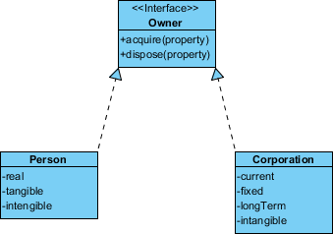
For example, the Owner interface might specify methods for acquiring property and disposing of property. The Person and Corporation classes need to implement these methods, possibly in very different ways.

Slide 32
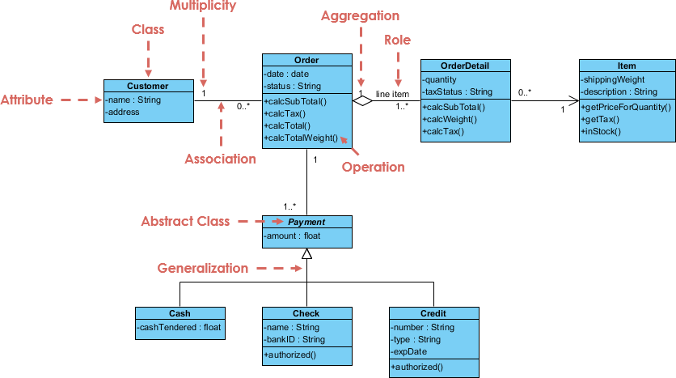
Class Diagram Example: Order System

Slide 33
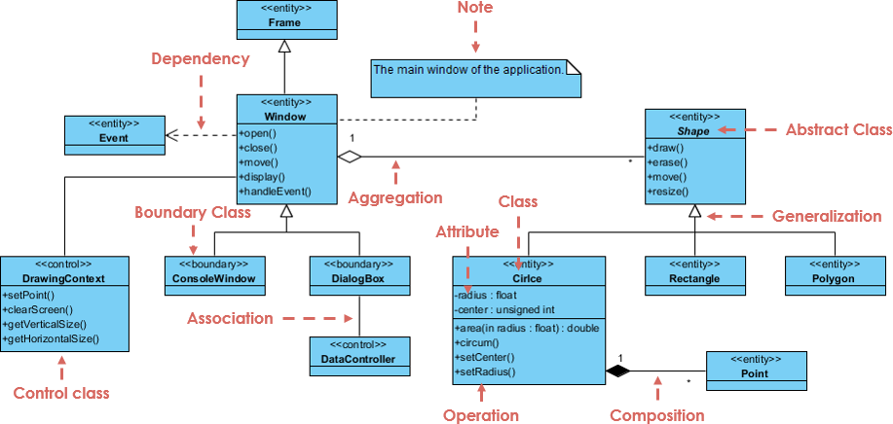
Class Diagram Example: GUI
A class diagram may also have notes attached to classes or relationships.

Slide 34
Thank You

